Slide 1
Computer Contracts & Software Liabilities LECTURE # 7

Slide 2
Fair Use Notice
The material used in this presentation i.e., pictures/graphs/text, etc. is solely intended for educational/teaching purpose, offered free of cost to the students for use under special circumstances of Online Education due to COVID-19 Lockdown situation and may include copyrighted material - the use of which may not have been specifically authorized by Copyright Owners. It’s application constitutes Fair Use of any such copyrighted material as provided in globally accepted law of many countries. The contents of presentations are intended only for the attendees of the class being conducted by the presenter.

Slide 3


Contract
A contract is an agreement between two or more persons or parties for doing or not doing any specified things.
The parties may be legal or natural persons.
Contract sets the following purposes:
Set out the agreement between the parties.
Set out the aims for the parties.
Provide for matter arising while the contract is running.
Ways of terminating the contract and the consequences.
What is essential:
All the parties must intend to make a contract.
All the parties must be competent to make a contract.
Mature enough and sufficiently sound mind to understand what they are doing.
There must be a consideration .
Each party must be receiving and providing something.

Slide 4
Contract law
If the contract are too harsh or unfair causing any issue between parties to be unresolved, it is the responsibility of contract laws to contemplate according to the rules.
It is largely based on common law
There are almost never disputes over contracts which rum perfectly.
In order to avoid disputes and future difficulties it is better to draft a document which sets out:
The terms on which both parties is to work.
Methods of payment.
Appropriate ways to terminate the contract-notice required.
Contract should be clear , concise and consistent. There should be no ambiguity and the parties to the agreement should be left in no doubt as to their rights and duties. Ambiguity and doubts can lead to performance which is viewed as unsatisfactory. This can lead to disagreement and the expenditure of time, effort and money, in resolving the matter

Slide 5

Fixed Price Contracts For Bespoke System
Software suppliers try to use what are known as standard form contacts, which are used or intended to be used many times over.
Typically consist of:
A short introductory section
States who the parties are
Stays anything that have been said or agreed before
Signed by the parties
Standard terms and conditions
Schedules or annexes
Many small-scale projects are carried out satisfactory using much simpler contracts, often no more than an exchange of letters
Notes:
Bespoke system are based on a 'one product fits all' and a best of breed concept to fulfil the needs of many.

Slide 6
What Is To Be Produced?
Contract necessarily states what is to be produced.
Usually two level of reference:
Standard terms and conditions refer to an annex.
The annex then refers to the requirement specification in a separate document.

Slide 7
What Is To Be Delivered?
Non exhaustive list of possibilities:
Source code
Command files (For building the executive from source)
Documentation (of the design and the code)
Manuals
Reference manuals
Training manuals
Operation manuals
Software tools to help maintaining the code
Training
For user
For client’s maintenance staff
Test data and test results

Slide 8
Rights Ownership
Stating what legal rights are being passed from the developer to the client is important.
Ownership in physical items will usually passed.
E.g. books, documents, disks
More than that, software is protected by intellectual rights:
Copyright
Design rights
Confidentiality
Trademarks
Contract should state who is to own these rights.

Slide 9
Confidentiality
The two parties may acquire confidential information about each other when a software is being developed.
Client may have to pass its business operations
Developer may not want the client to divulge to others about its operations
In this case, the contract should state the non disclosure agreement.
Notes:
Divulge : Raz Faash Karna : Break Bring Out Disclose Discover Expose

Slide 10
Payment Terms
The standard terms and conditions will specify the payment conditions,
Eg: Payment shall become due within 30 days of invoice issue date. If payment is delayed by more than that, the company shall have the right to terminate the contract or to apply surcharges at an interest rate.
In practice, such clauses are brought into effect in extreme case, since using them is likely to destroy the goodwill between developer and client on which the success of the project depends.

Slide 11
Payment Terms
An annex usually specifies a pattern of payment,
E.g:
An initial payment of 15% becomes due on signature of the contract
55% at various states during the development
20% on acceptance of the software
The final 10% at the end of the warranty period
Such pattern has advantages for the developer in that it reduces:
The financial risk
Possible cash flow difficulties

Slide 12
Payments For Delays And Changes
Frequently, progress of the development is delayed because the client does not meet obligations on time.
The developer will be expected its best to rearrange activities to avoid wasting effort, but it is not always possible.
Therefore, the contract should make provision for payments to compensate for :
The wasted effort when the client fails to meet its obligation on time
Extra work when changes are requested

Slide 13
Calculating Payments For Delays And Changes
The contract must specify the process these extra payments are calculated
Typically, annex will include daily charging rates for each grade of staff employed on the contract.
The amount of extra effort to be paid for will be agreed at progress meetings.

Slide 14
Penalty Clauses
When delay caused by developer .
Normal mechanism is the sum payable to the developer is reduced by a specified amount for each week that acceptance of the product is delayed, up to certain maximum
E.g. contract value 1 million PKR. Penalty 5,000 PKR per week up to maximum 100,000

Slide 15
Warranty And Maintenance
Once the product has been accepted, it is common to offer a warranty period, typically 90 days.
Any errors found within this period will be corrected free of charge.
This clause is subject to negotiation.
After warranty period, maintenance can be available on request.

Slide 16
Termination Of Contract
There are many reasons to necessarily terminated a contract before it has been completed. It is common practice.
It is essential that the contract make provision for terminating the work in an amicable manner.
Usually, it means that the developers to be paid for all the work carried out up to the point where the contract is terminated.
The question of ownership of the work so far carried out must also be addressed.

Slide 17
Arbitration
Court action is expensive. Contract often contain a clause saying that, in the event of a dispute that they cannot solve themselves the party agree to accept the decision of an independent arbitrator.
Where the developer and the client in different legal jurisdictions or performance of the contract involves more than one jurisdiction, it is necessary to state which laws the contract is to be interpreted.

Slide 18

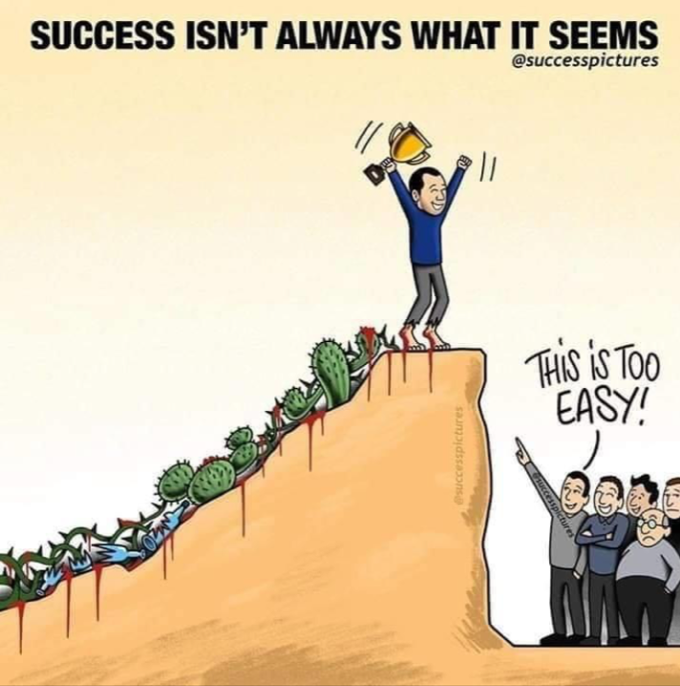


Lesson For Life

Slide 19
Thank you… Questions….??? If Any…

